Slide 1
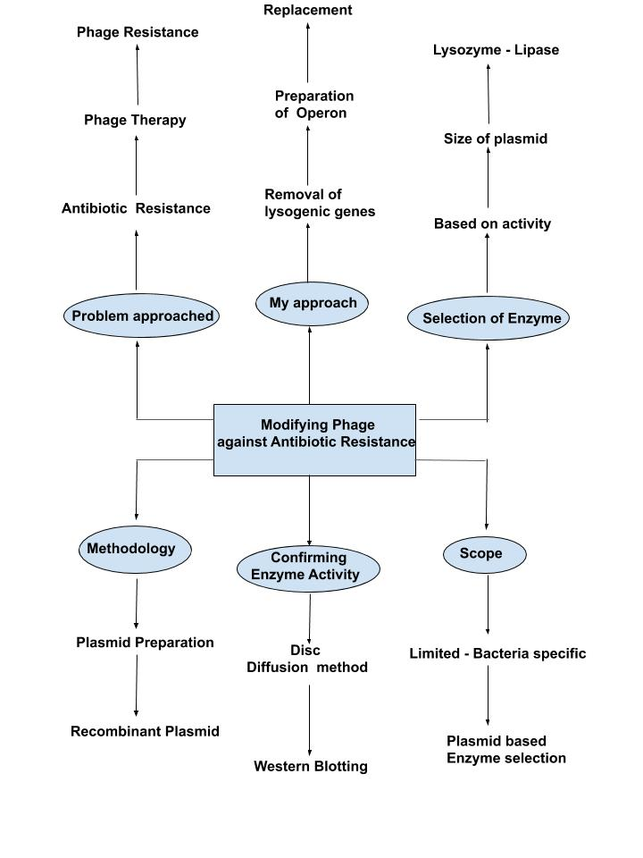

Thinkathon
April 27,2020
Name: Raksham Tiwari
Roll no. : B18BB028
Problem Statement
35 thousand Americans are dying every year due to Antibiotic Resistance
Phage therapy helps lysing specific bacteria
Bacterial Defense may lead to Phage Resistance
Thus addressing the problem of Antibiotic resistance with an advanced phage therapy
My approach
Constructing an operon
Replacing genes for lysogeny with operon
Confirmation of Enzyme Activity

Slide 2
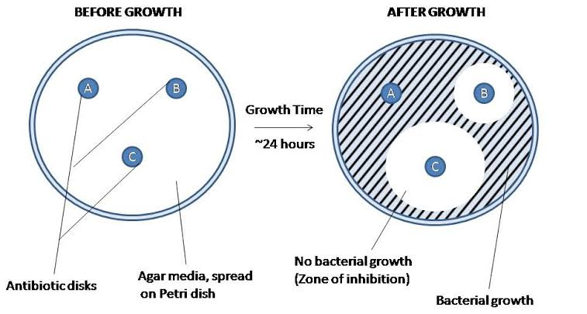
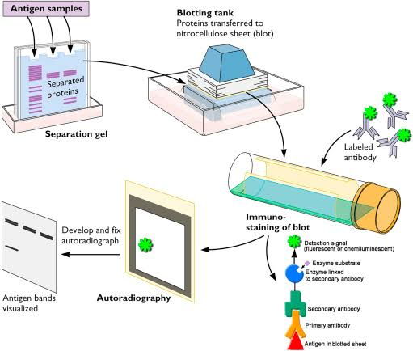
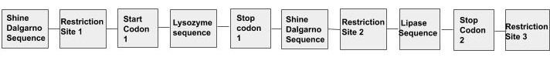
Methodology
Recombinant DNA Formation
1. Selection of Enzyme and construction of operon
2. Recombinant plasmid is made with replacement of lysogenic genes with newly made operon
Confirming the enzyme activity
Disc Diffusion Method
The solution is transferred to a filter paper disc.
Zones of inhibition resulted from Disc Diffusion method
Protein separation (from zones of inhibition) by SDS PAGE
Antibodies with specific markers are then used for the identification of desired proteins.
Use of Western Blotting
Start Codon 1
Operon construct

